Slide 1
BCDV1011 Design Patterns for Blockchain
Tokens and token factories

Slide 2
Tokens and token factories
Utility tokens
Example utility token
Token factory use case
Build a token factory

Slide 3
Utility Tokens
Needs to be an integral part of a system - not just a stand-in for a security
Based on ERC20
Added extra functions to provide utility
Can be used to pay for
Resource usage
Access
Votes
Royalties
Rewards

Slide 4
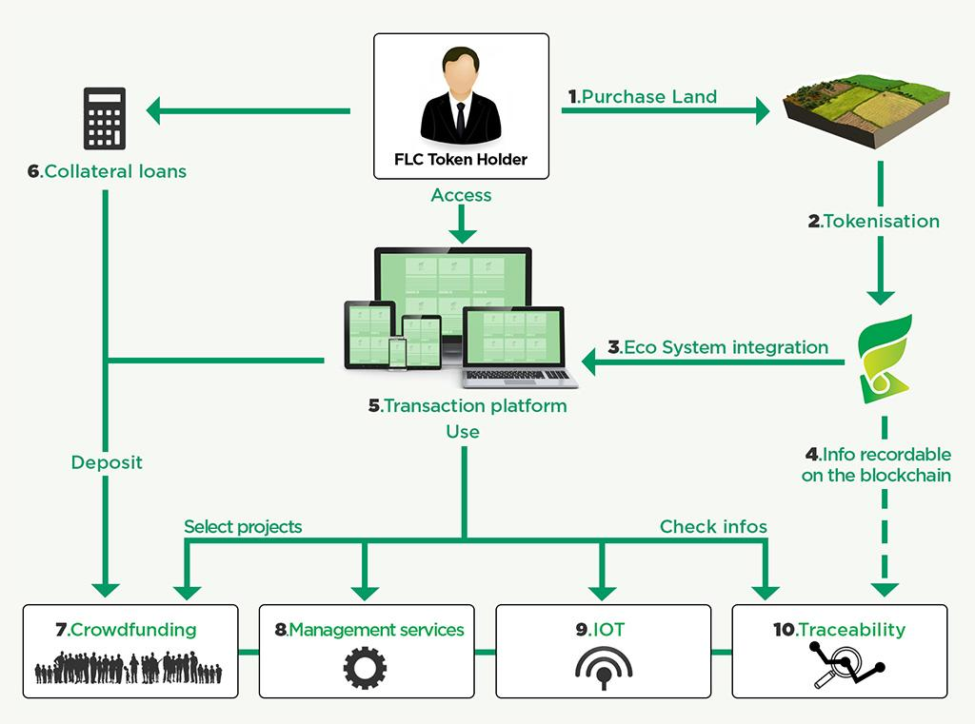
Fieldcoin - example
Crowdfunding for agricultural land purchases

Slide 5
Fieldcoin - example
https://github.com/Fieldcoin/Fieldcoin-ERC20
Two tokens
FieldCoinSale - pre-sale token for special enticements
FieldCoin - token for working with the FieldCoin system
FieldCoin is mintable, burnable
FieldCoinSale is crowdsale, pausable
Derived from StandardToken and ERC20

Slide 6
Token factory - use case
Art provenance
The goal
To show a clear line of ownership for a work of art from artist to current owner.
People involved
Artist - originator of the art work
Owner - current owner of the artwork
Requirements
Only one owner at a time
Artist can create new works of art

Slide 7
Token factory - use case
The artist can have a collection of artworks that they have created
contract Artist {
// Collection of artworks by this Artist
mapping(uint => ArtWork) artworks;
address artist;
constructor() public {
artist = msg.sender;
}

Slide 8
Token factory - use case
The artist can make new artworks and add them to their collection
function createArtwork(uint hashIPFS, string memory Name) public returns (ArtWork) {
ArtWork artContract = new ArtWork(hashIPFS, Name);
artworks[hashIPFS] = artContract;
return artContract;
}
Check to see if the artist is the originator of an artwork
function checkArtwork(uint hashIPFS) public view returns(bool) {
if(artworks[hashIPFS] == ArtWork(0x0)) {
return true;
}
return false;
}

Slide 9
Token factory - use case
An artwork is stored on IPFS and we keep the hash and name of the artwork on the blockchain
contract ArtWork {
// Detail of artwork
address artist;
string name;
uint hashIPFS;
address owner;
constructor(uint ipfsHash, string memory artName) public {
artist = msg.sender;
name = artName;
hashIPFS = ipfsHash;
owner = artist;
}

Slide 10
Token factory - use case
An artwork is stored on IPFS and we keep the hash and name of the artwork on the blockchain
contract ArtWork {
// Detail of artwork
address artist;
string name;
uint hashIPFS;
address owner;
constructor(uint ipfsHash, string memory artName) public {
artist = msg.sender;
name = artName;
hashIPFS = ipfsHash;
owner = artist;
}

Slide 11
Token factory - use case
An artwork can change ownership
function setOwner(address newOwner) public {
if(owner == msg.sender) {
owner = newOwner;
}
}

Slide 12
Token factory - Assignment
Create an ERC721 non-fungible token that can represent an artist
Create an ERC721 non-fungible token that can represent an artwork
The artist token needs to have a token factory to create new artworks
Put your tokens into GitHub send me your github link to dave@polytiersoftware.com

